Slide 1
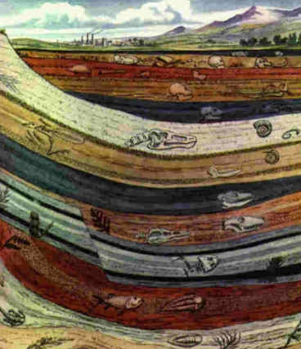

Fossil Evidence for Evolution
Tree Ring Dating
Relative Dating
Stratigraphy
Phylogenetic Trees
Geological Time Scale
Problems with Fossil Record

Slide 2
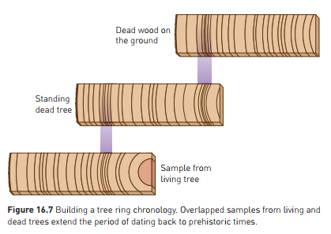
Tree Ring Dating (Dendrochronology)
Another form of absolute dating
Trees grow concentric rings
Each ring = 1 year growth
Differ in width according to growing season
Create a “Timeline” in the tree trunk
Can match “years” by comparing one sample to another.
Can therefore match historically, and count years.

Slide 3
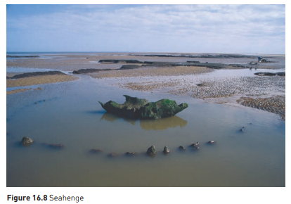
Tree Ring Dating (Dendrochronology)
Old, living trees are particularly useful for this
Bristlecone pine – USA – living trees up to 4500 years old
Can then look at dead trees, and backtrack using comparison
Can date very accurately back to 8600 years ago
Can use this to verify accuracy of Carbon-14 dating
Example: Seahenge
Timber circle – coast of England
Analysis of central stump using combo of tree-ring and carbon dating
Middle stump: tree chopped down in 2049 BC (4000 years ago), and was 167 years old when felled.

Slide 4
Tree Ring Dating (Dendrochronology)
Limitations:
Timber only rarely preserved long enough to do long dating
Depends on having a continuous succession of nearby timber

Slide 5
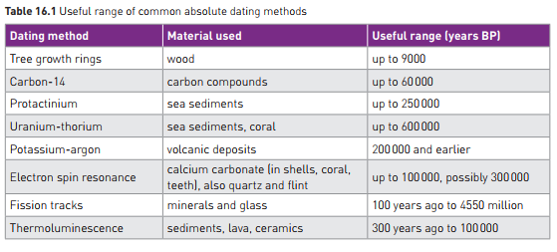

Slide 6
Relative Dating - Stratigraphy
Determines how old one sample is, compared to other samples
Enables sequence of events to be established
Stratigraphy: study of layers, or strata
Principle of Superposition
In sedimentary rock, layers at top are younger than layers beneath
Need to be cautious, as distortions of Earth’s crust can disturb layers, leading to inaccuracy.
Correlation of Rock Strata
Matching layers of rock from different areas
Examining rock, and also fossils it contains
Rocks containing similar fossils are likely to be of similar age

Slide 7
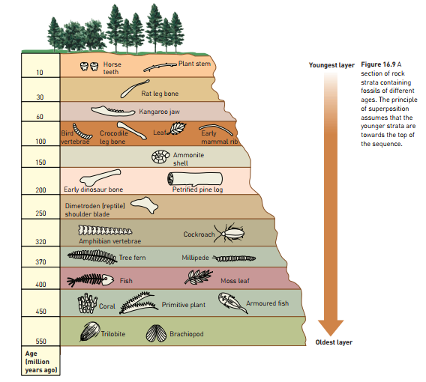

Slide 8
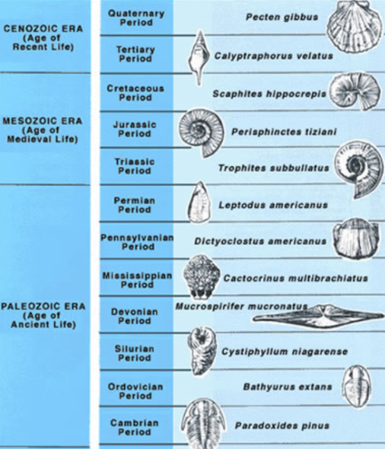
Relative Dating - Stratigraphy
Index fossils:
Widely distributed on earth but only present for a short historical time.
Can be used to correlate strata from different areas of the earth

Slide 9
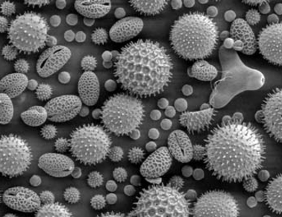
Relative Dating - Stratigraphy
Fossil pollen grain analysis
Some useful as Index Fossils
Can be used to get a picture of type and amount of vegetation present at the time the fossils formed.
Can be used to infer information about climate
Can then be used to confirm relative dates

Slide 10
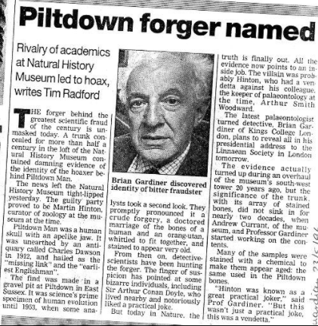
Relative Dating – Fluorine Dating
Bone left in soil, fluoride ions replace some of the ions in the bone.
All fossil bones in a particular deposit should contain same amount of fluoride
Can therefore detect fossils that have been displaced
Older fossils, more fluorine as have been there longer
Can’t use to absolute date though, as amount of fluoride in water supply fluctuates over time.
Example: “Piltdown Man” hoax
1953 – fossil claimed to be of “human ancestor”
Fluorine dating showed it to be a hoax:
Skull old, but jawbone modern – from orang-utan.

Slide 11
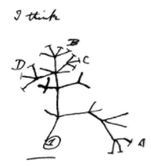
Phylogenetic Trees
Using a range of dating, biotech and classification techniques, scientists can work out likely evolutionary relationships
Probably relationships can be represented as a diagram, called a phylogenetic tree.
Ancestral organism at the base
More recent organisms at end of branches
Forks in branches: common ancestors
Have been used since Darwin’s time.

Slide 12
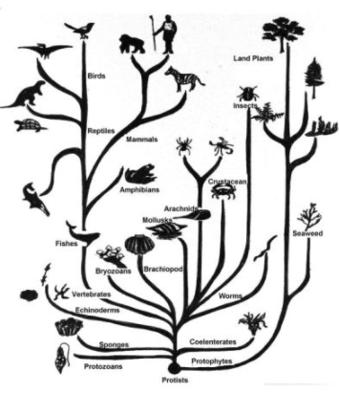
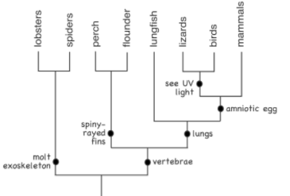
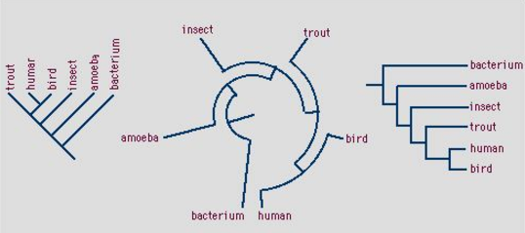

Slide 13
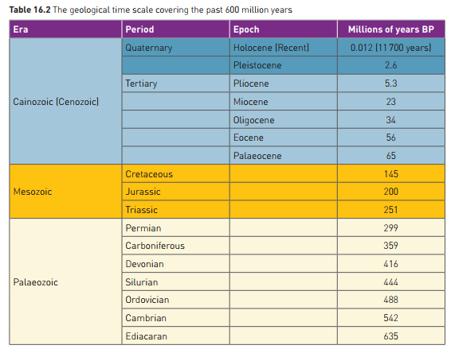
The Geological Time Scale
Enormous time span involved in the evolutionary process
First life approx 3.5 billion years ago
Divided into eras, periods, epochs:

Slide 14
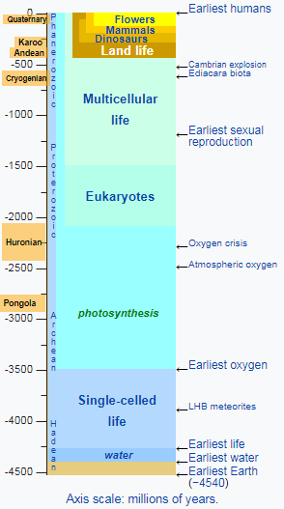
The Geological Time Scale
Humans and human ancestors relatively very recent:
Cainozoic onwards

Slide 15
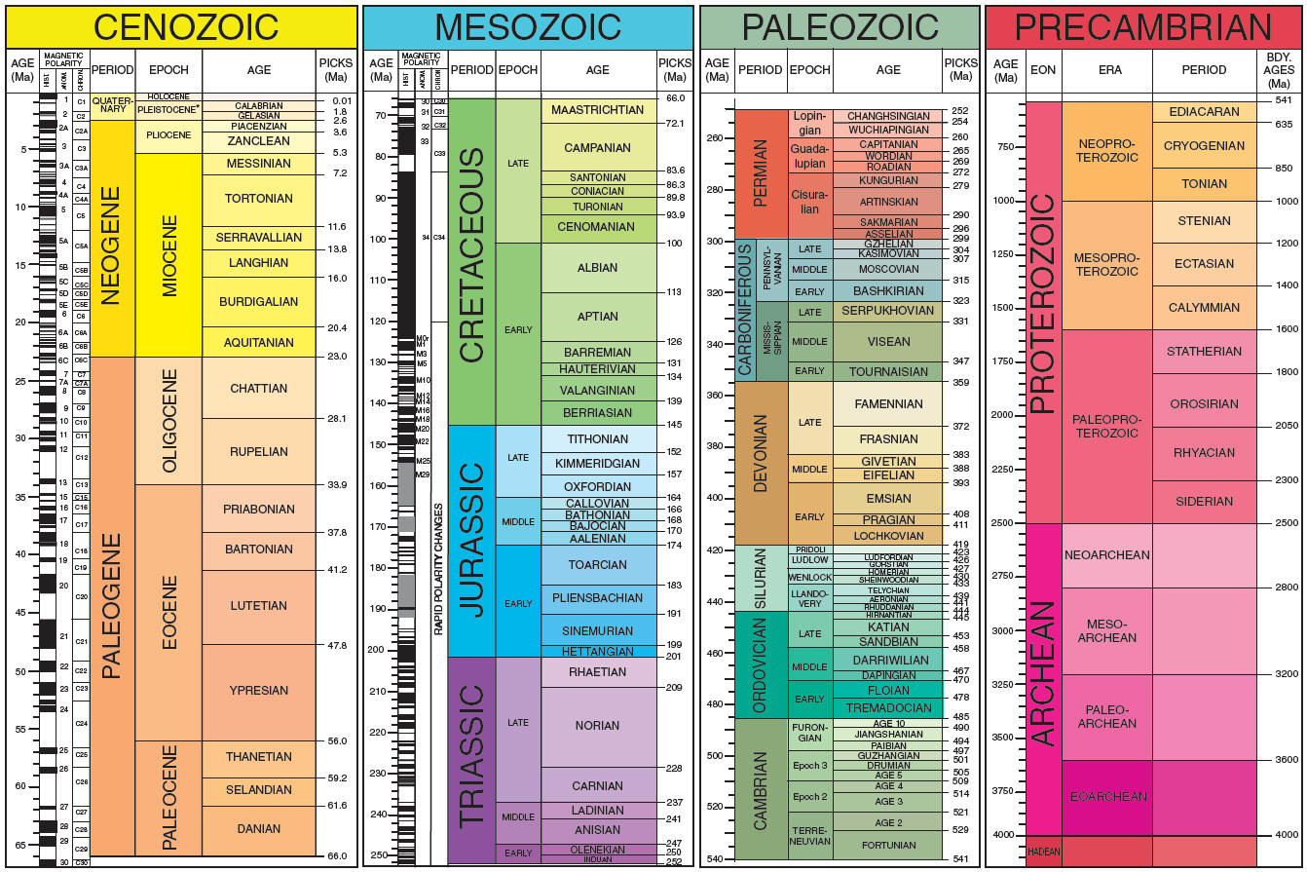

Slide 16
Problems with the fossil record
Incomplete: few fossils formed as specific conditions required:
Quick burial
Presence of hard body parts, or imprint
Absence of decay organisms
Long period of stability
Correct environmental conditions eg soil pH
Only some fossils formed get found
Dating material can be problematic in some cases
Fossils often incomplete

